Slide 1
How to Logout of Google Drive
Don’t forget!

Slide 2
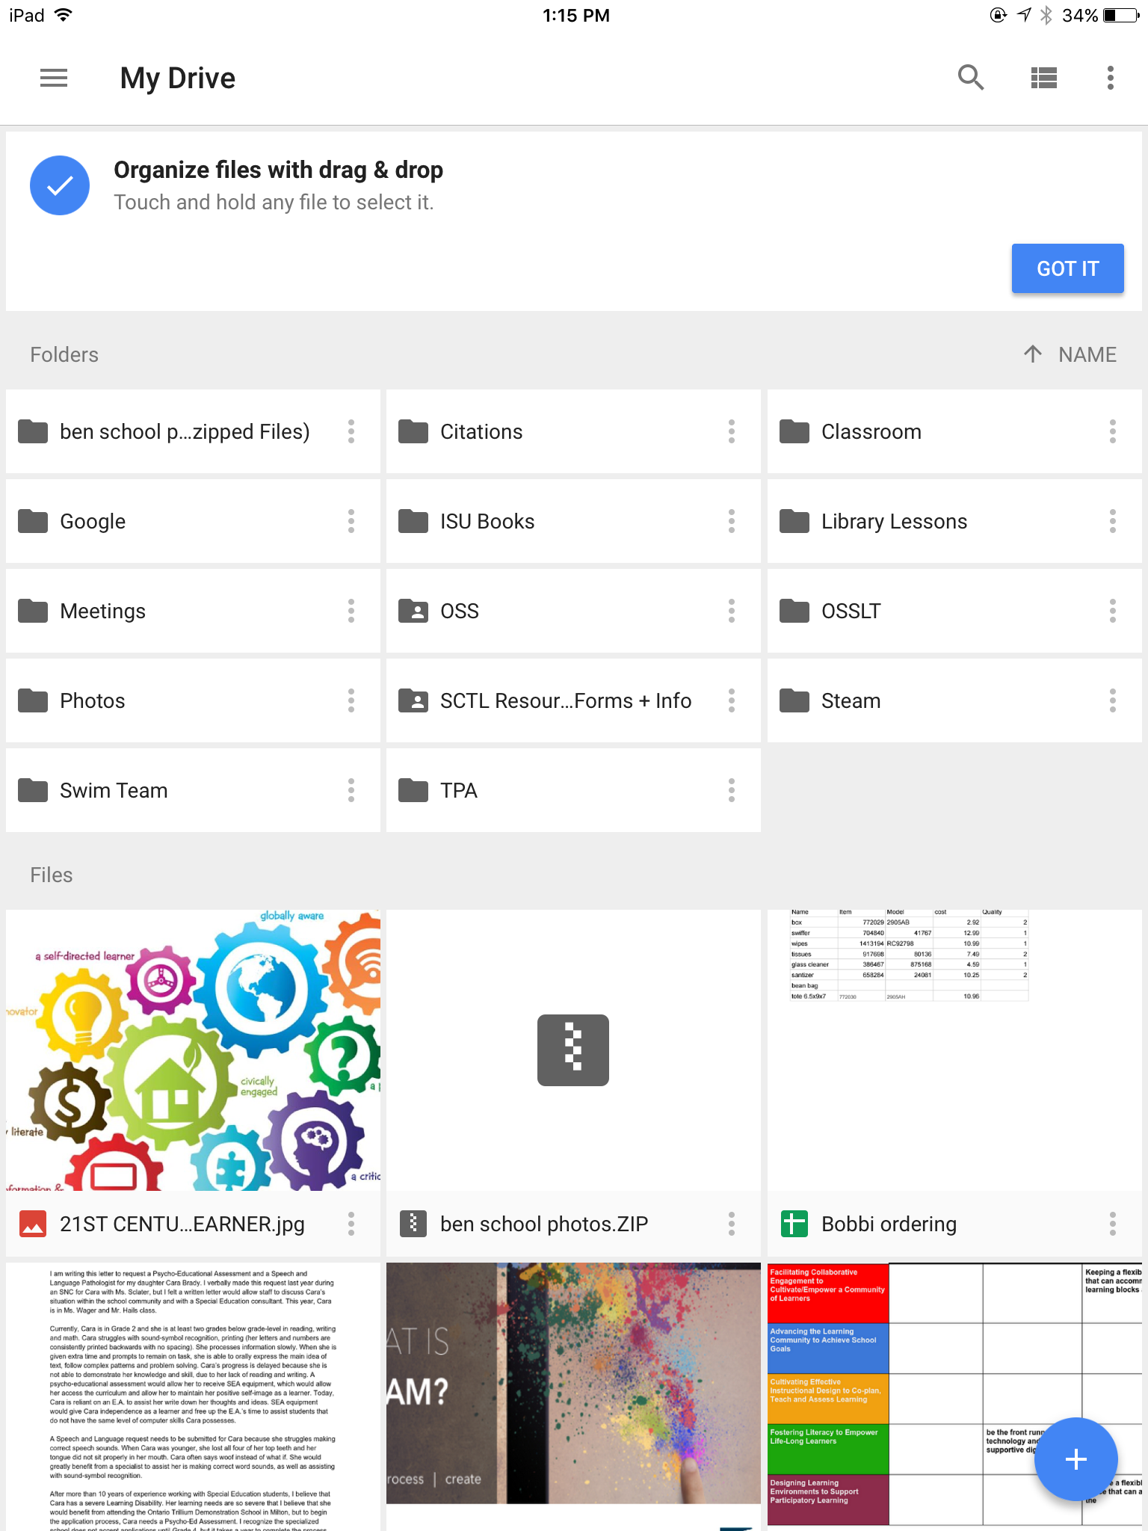
To the Left is my Google Account - still logged on
Click
Anyone can access your files. If you are logged into Google Classroom, someone can record inappropriate information, or leave a comment.

Slide 3
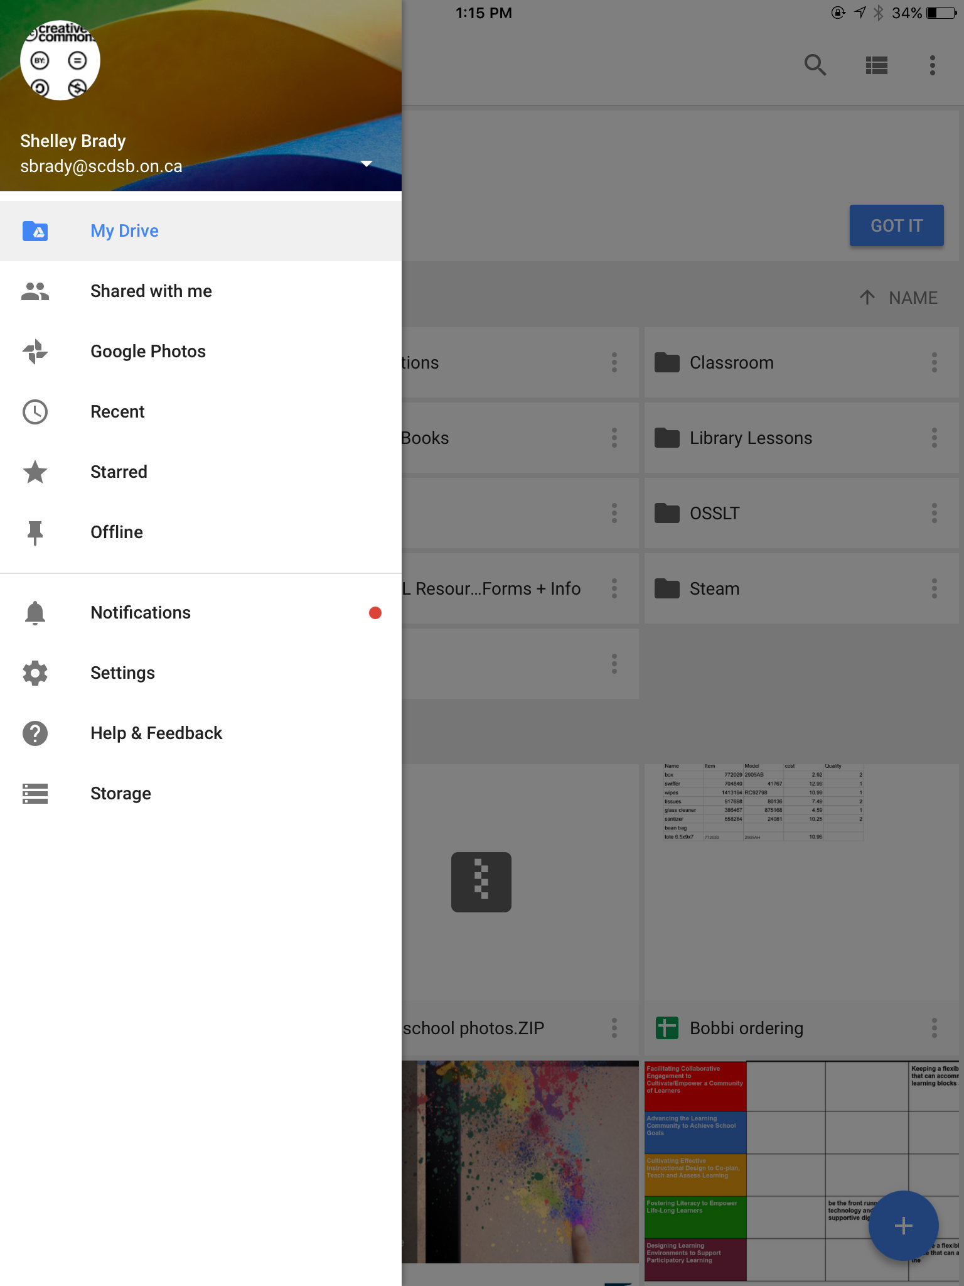
.
Click on the

Slide 4
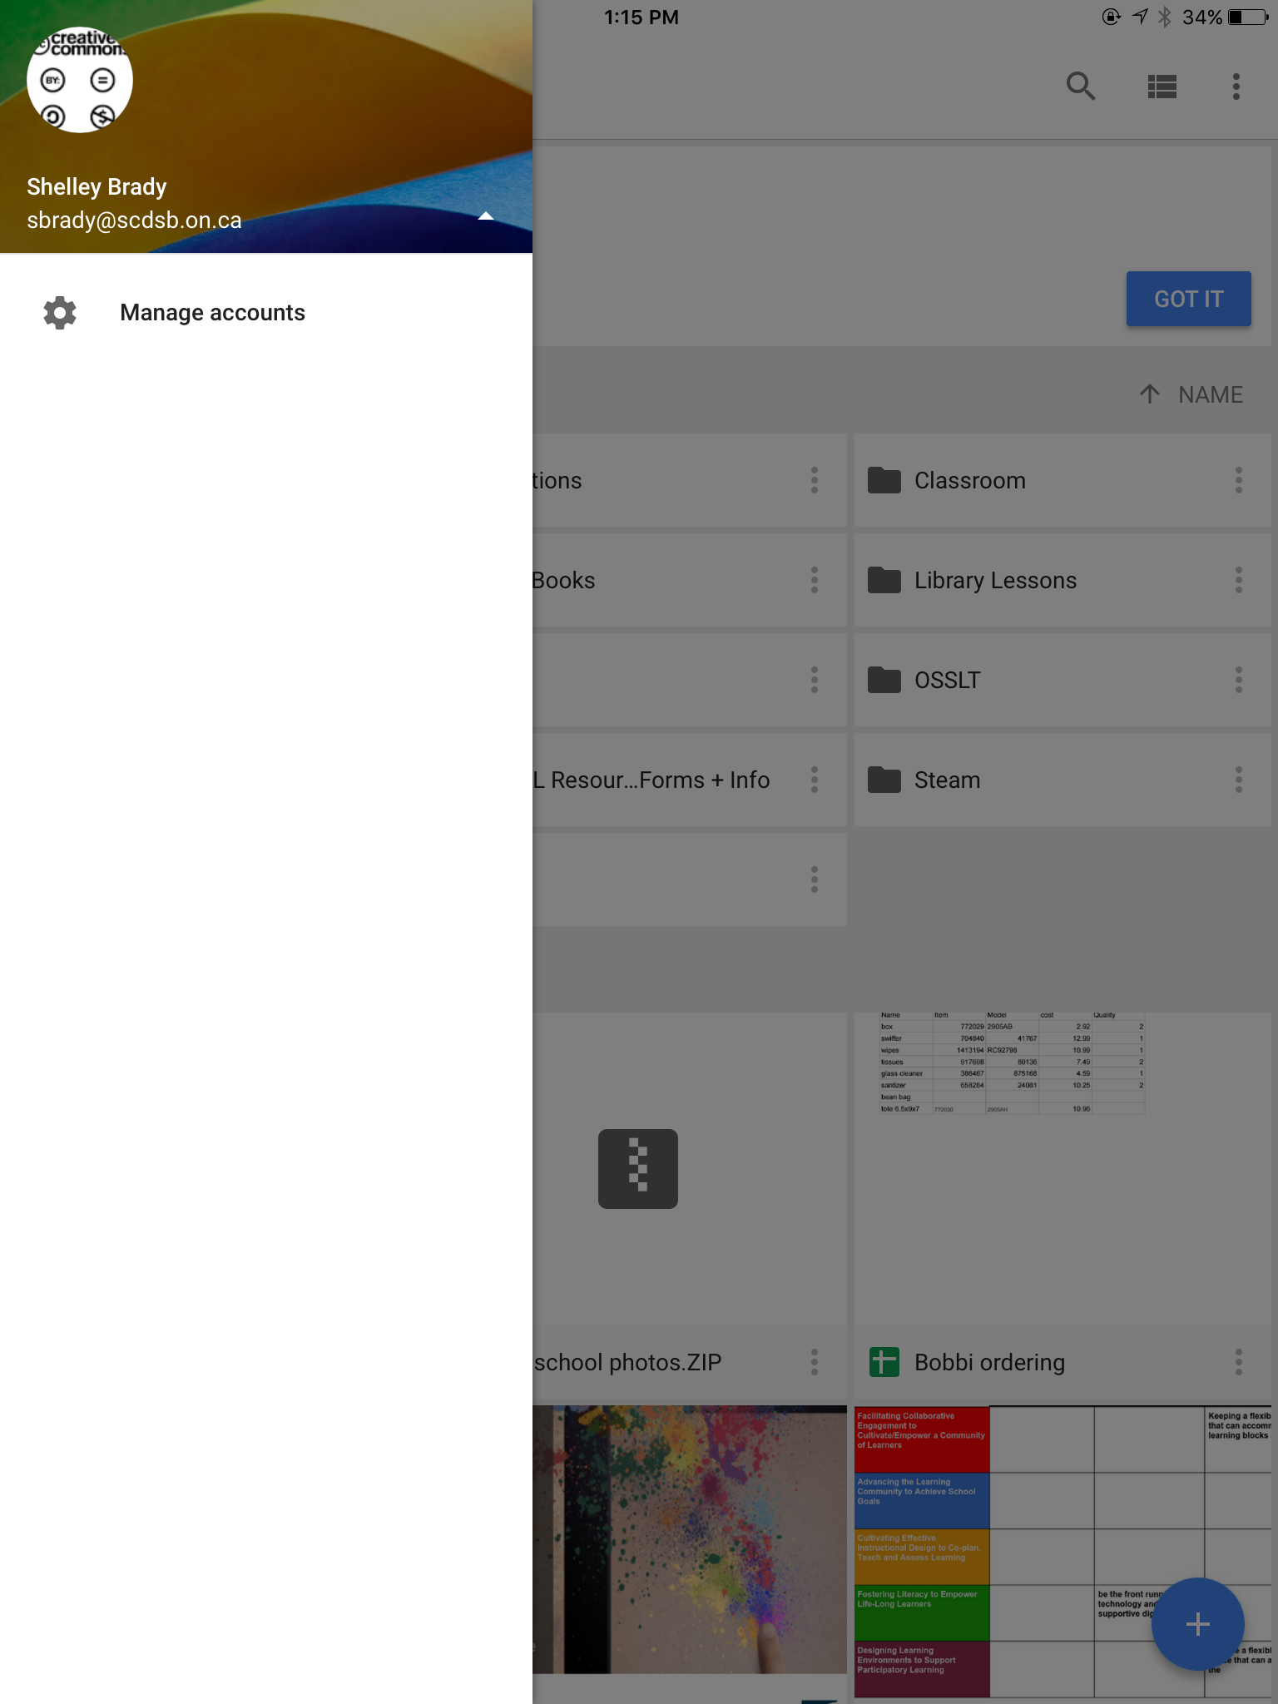
Click on Manage Accounts
.

Slide 5
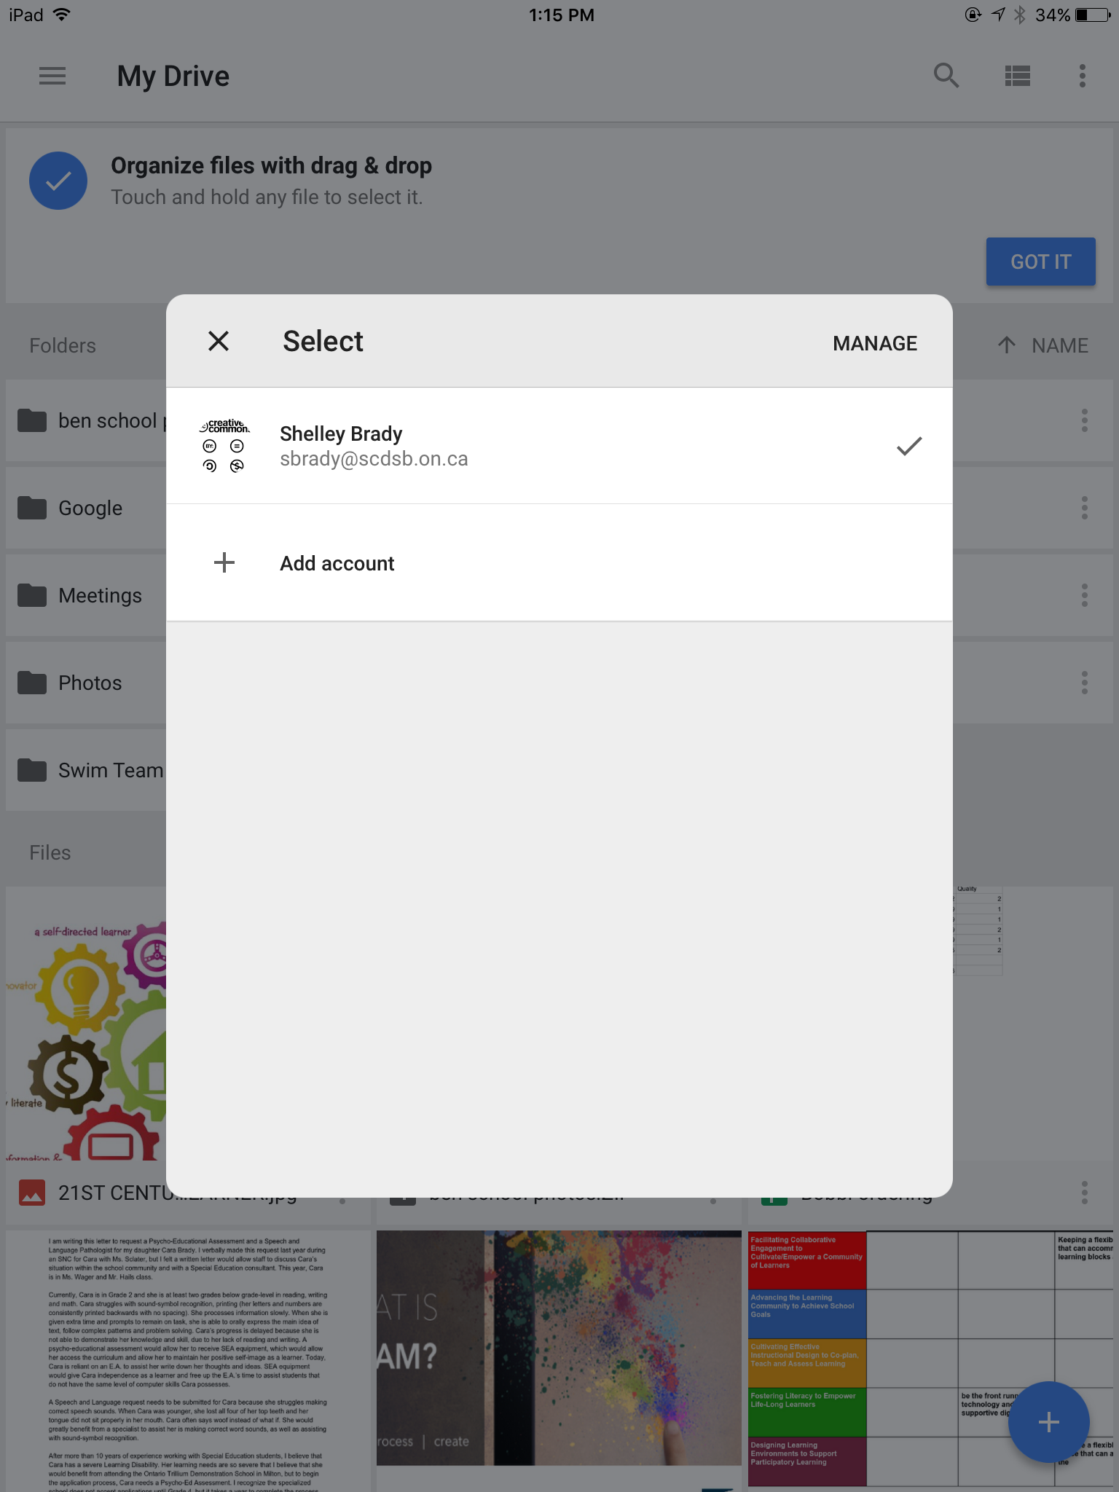
.
Click on the word Manage

Slide 6
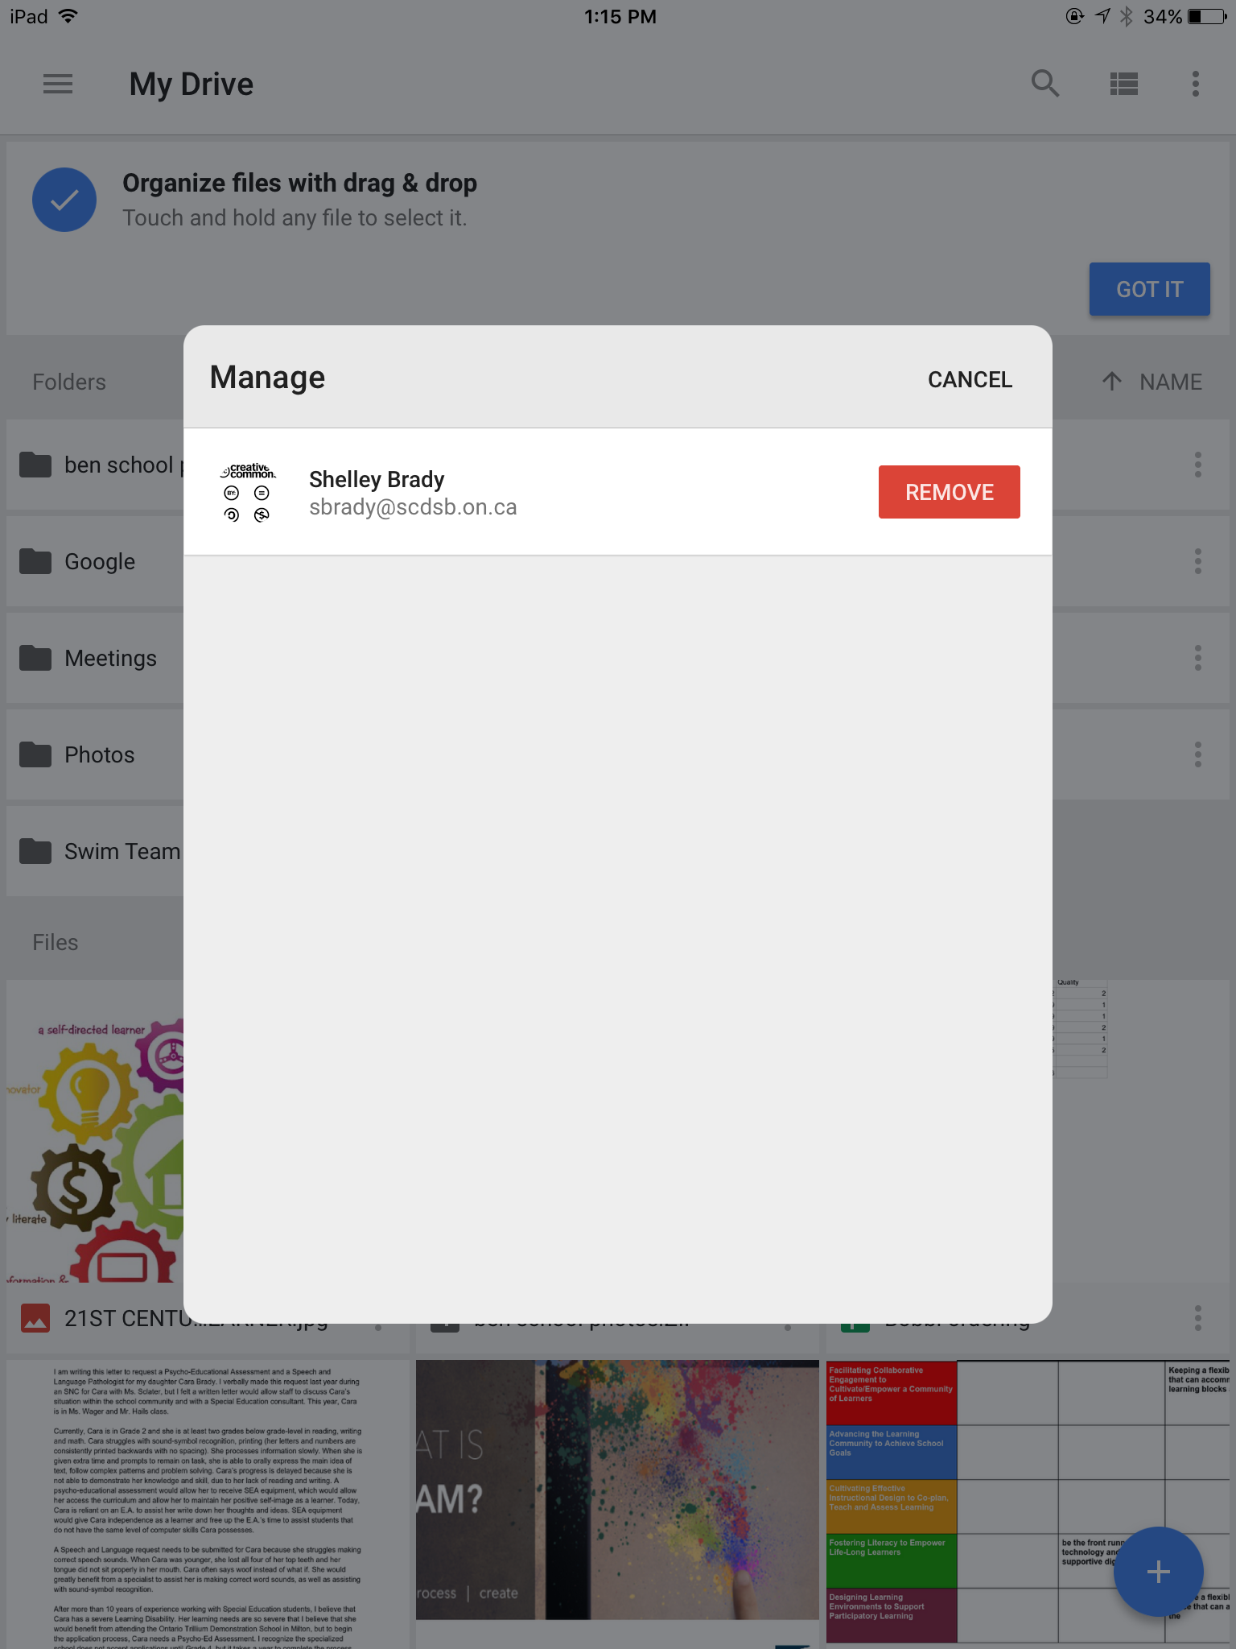
Click on

Slide 7
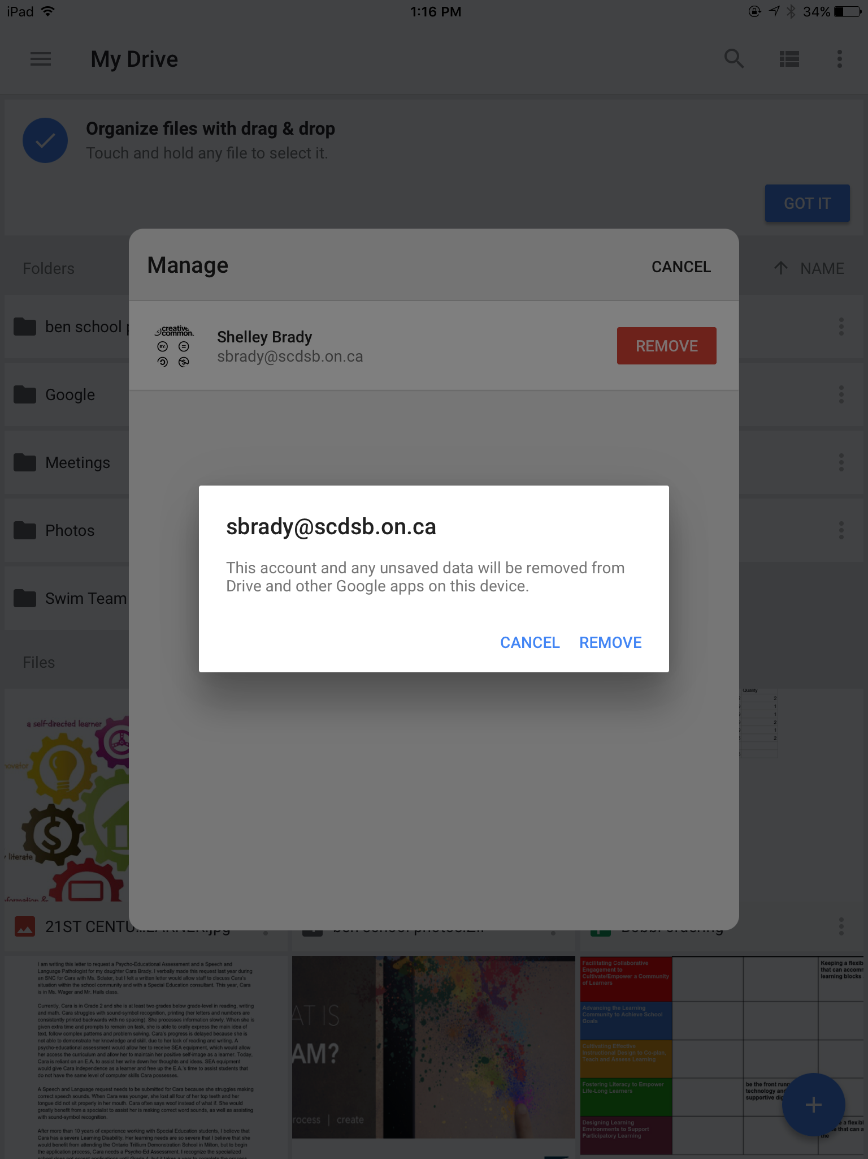
Click
A

Slide 8
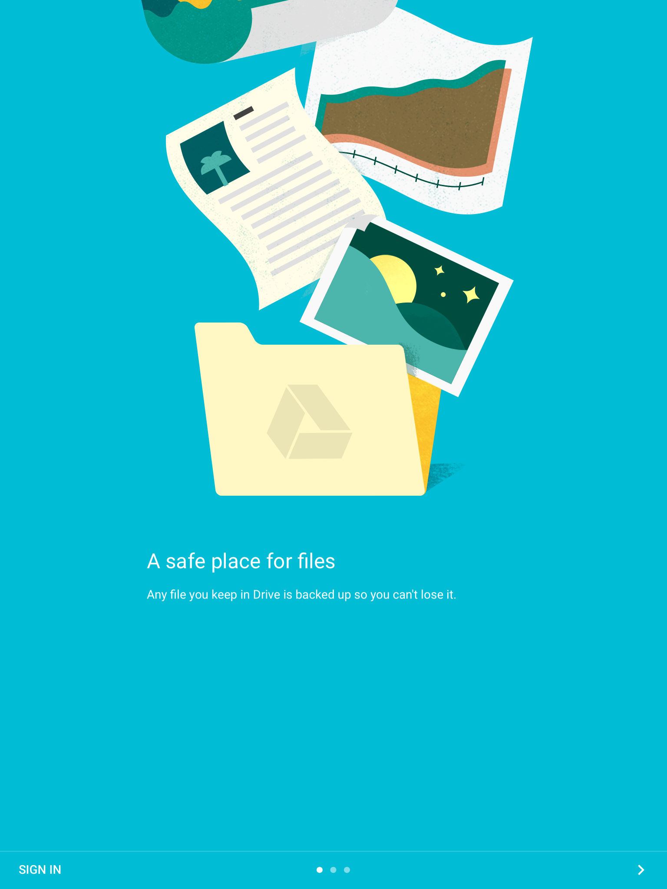
When you see this Screen
Success!

